Slide 1
Properties of
Regular Languages

Slide 2
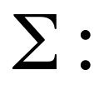
正则运算
26个英文字母
A={good,bad},B={boy,girl}
定义 2.10 设 A 和 B 是两个语言，定义正则运算并、连结和星号如下：
并： A∪B ＝｛ x |x∈ A 或 x∈B }
  把 A 和 B 中的所有字符串合并在一个语言中
  A∪B ＝{good,bad, boy,girl}
连结： A。B ＝｛xy| x ∈ A 且 y ∈ B }
  A 中的任一字符串接在 B 中的任一字符串的前面。
  A。B ＝{goodboy，goodgirl，badboy，badgirl}
星号： A* ＝ { x₁x₂…x_{k}|k≥ 0 且每一个 x _{i}∈ A }
  一元运算。A 中的任意个字符串连结在一起得到新语言中的一个字符串。空串:总是 A*的一个成员
  A* ＝{ε，good，bad，goodgood，goodbad，……}
Notes:
.

Slide 3




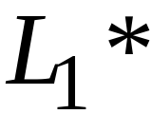
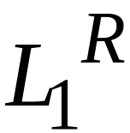


For regular languages and
we will prove that:
Union:
Concatenation:
Star:
Are regular
Languages
Reversal:
Complement:
Intersection:

Slide 4
闭包特性
We say: Regular languages are closed under
Union:
Concatenation:
Star:
Reversal:
Complement:
Intersection:

Slide 5
Union of Two Languages
语言并集 ep45 cp35-36
Theorem 2.12: If A₁ and A₂ are regular
languages, then so is A₁ ∪ A₂.
(The regular languages are ‘closed’ under
the union operation.) 正规语言之并集仍正规
Proof idea: A₁ and A₂ are regular, hence there are two DFA M₁ and M₂, with A₁=L(M₁) and A₂=L(M₂).
Out of these two DFA, we will make a third automaton M₃ such that L(M₃) = A₁ ∪ A₂.
注意三个机器都是确定的，所以证明很艰苦，后面有简化方法
思想 ：并机识别并语, 类似 x→log(x), y→log(y), log(x)+log(y)= log(x*y),然后求出 x*y

Slide 6
Proof Union-Theorem (1) 证明并机定理cp-27
给定 M₁=(Q₁,Σ₁,δ₁,q₁,F₁) and M₂=(Q₂,Σ₂,δ₂,q₂,F₂)
Define M₃ = (Q₃,Σ₃,δ₃,q₃,F₃) by: 造机（并机）
Σ₃ = Σ₁ ∪ Σ₂
M₃在M₁或者M₂接受输入串的时候接受输入串；
M₃如何模拟M₁和M₂?
如果先模拟M₁, 模拟M₂?
  输入带要重新绕回去。
在一个输入时，M₁或M₂都可能动作，
  r₁→r’₁ (δ₁)
  r₂→r’₂ (δ₂)
  (r₁ ,r₂) | (r₁ ∈ Q₁且r₂ ∈ Q₂
{
}

Slide 7
Proof Union-Theorem (1) 证明并机定理cp-27
给定 M₁=(Q₁,Σ,δ₁,q₁,F₁) and M₂=(Q₂,Σ,δ₂,q₂,F₂)
Define M₃ = (Q₃,Σ,δ₃,q₃,F₃) by: 造机（并机）
Q₃ = {(r₁,r₂) | r₁∈Q₁ and r₂∈Q₂} = Q₁×Q₂
状态：两个公司 强强联合后，办事机构作迪卡积
δ₃((r₁,r₂),a) = (δ₁(r₁,a), δ₂(r₂,a))
转换函数 ：r1,r2两个公司的机构，对同一输入a，先自治，再转入联合的下一办事机构
q₃ = (q₁,q₂) 起态联合成为起态
F₃ = {(r₁,r₂) | r₁∈F₁ or r₂∈F₂} 接受态 ”或”
两个公司之一的检验员检验合格即可，
注意 如果换为 and ,则接受两个语言的交集

Slide 8
Concatenation of L₁ and L₂ 链接
Definition: L1• L2 = { xy | x∈L1 and y∈L2 }
字集链接 = 链接字集
Example: {a,b} • {0,11} = {a0,a11,b0,b11}
Theorem 2.13: If L₁ and L₂ are regular languages, then so is L₁•L₂.
(The regular languages are ‘closed’ under concatenation.) 正规语言之链接仍正规，链接定理

Slide 9
为证明链接定理遇到困难，引入不确定性
Consider the concatenation: 考虑下列链接
{1,01,11,001,011,…} • {0,000,00000,…}
(That is: the bit strings that end with a “1”, followed by an odd number of 0’s.)
Problem is: given a string w, how does
the automaton know where the L₁ part
stops and the L₂ substring starts?
如何知道L1 何处停止？ L2 何处开始。切分问题。
直接可以证明， 但很难叙述。
We need an M with ‘lucky guesses’.

Slide 10



A useful transformation: use one accept state
NFA
2 accept states
Equivalent
NFA
1 accept state

Slide 11
In General
NFA
Equivalent NFA
Single
accepting
state

Slide 12
Extreme case
NFA without accepting state
Add an accepting state
without transitions

Slide 13
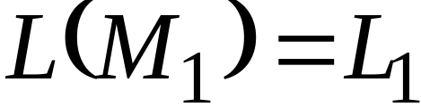
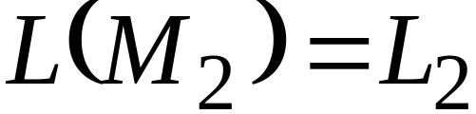


Take two languages
Regular language
Regular language
NFA
NFA
Single accepting state
Single accepting state

Slide 14

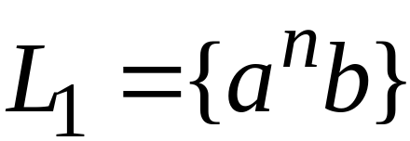
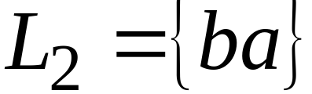
Example

Slide 15

Union
NFA for

Slide 16
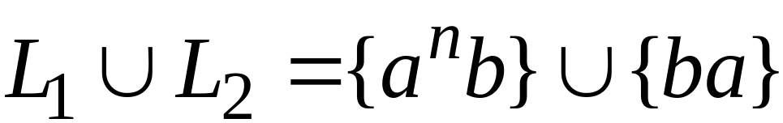

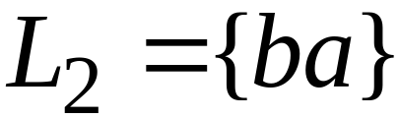
Example
NFA for

Slide 17
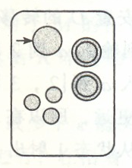
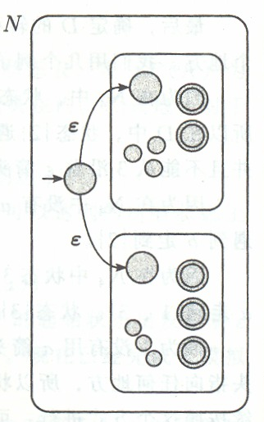

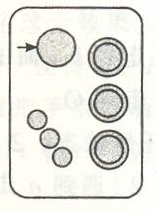
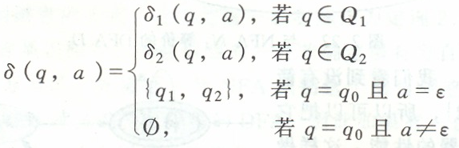
Proof Union-Theorem (2) 证明并机定理1.12 cp35
M₃是一个非确定性的有限自动机，记做N。
构造识别 A₁∪A₂ 的 N = (Q,Σ,δ,q0,F)
1)
2) q₀ 是 N 的起始状态。
3) 接受状态 F = F1 ∪ F2 。
4) 定义δ如下：对每一个 q ∈Q 和每一个 a ∈ Σ 。
M₁
M₂

Slide 18

Concatenation
NFA for

Slide 19
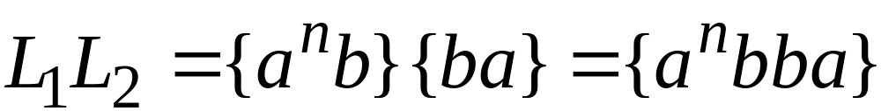

Example
NFA for

Slide 20
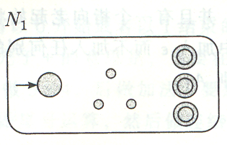
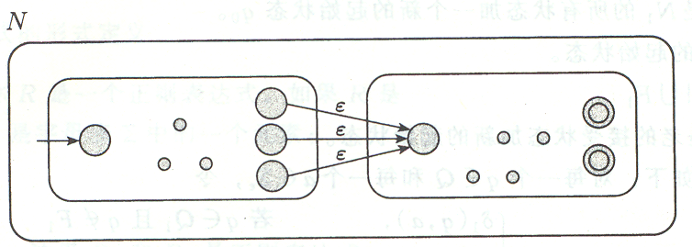
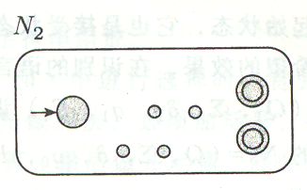

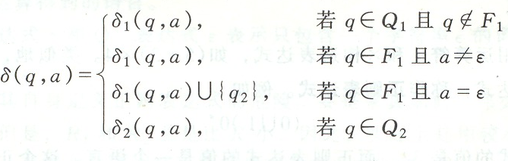

证明 正则语言族 对 并、连接、星运算、 补，交 封闭 cp36-37
设NFA M_{K} 识别RL L_{K ,} K=1,2 造 M₃ M₄ M₅ 如下
2 M4识别 L1●.L2
M1 M2
M4
A₂

Slide 21
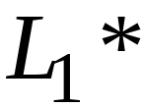
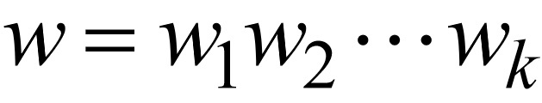

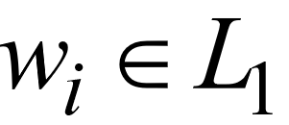
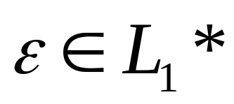
Star Operation
NFA for

Slide 22
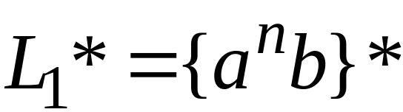

Example
NFA for

Slide 23
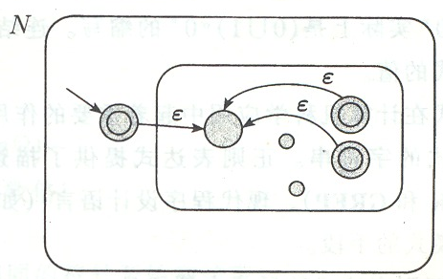
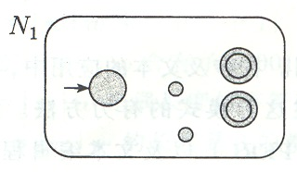
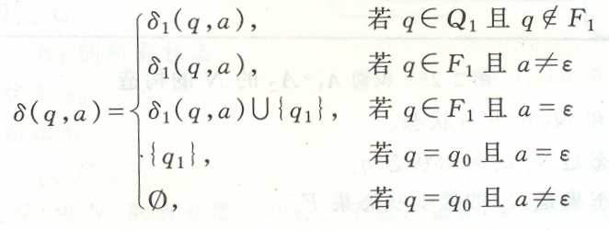


证明 正则语言族 对 并、连接、星运算、 补，交 封闭 cp36-37
设NFA M_{K} 识别RL L_{K ,} K=1,2 造 M₃ M₄ M₅ 如下
3 M5 识别 (L1)*
M1
M5

Slide 24
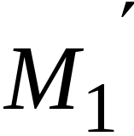

Reverse
NFA for
1. Reverse all transitions
2. Make initial state accepting state
and vice versa

Slide 25
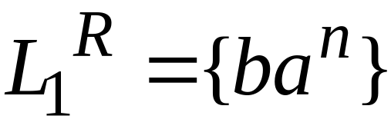
Example

Slide 26
Complement
1. Take the DFA that accepts
2. Make accepting states non-final,
and vice-versa

Slide 27

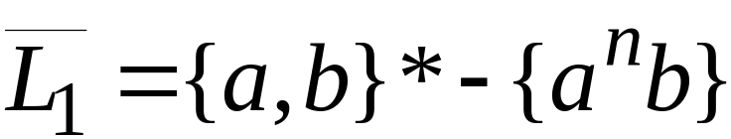
Example

Slide 28
Intersection
regular
We show
regular
regular

Slide 29




DeMorgan’s Law:
regular
regular
regular
regular
regular

Slide 30
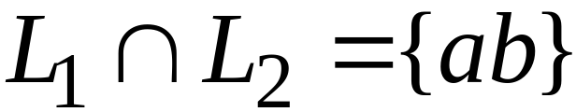
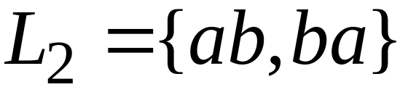
Example
regular
regular
regular

Slide 31

Another Proof for Intersection Closure
Machine
Machine
DFA
for
DFA
for
Construct a new DFA that accepts
simulates in parallel and

Slide 32

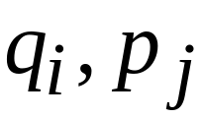
States in
State in
State in

Slide 33




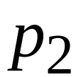
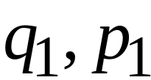
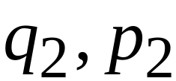
DFA
DFA
transition
transition
DFA
New transition

Slide 34

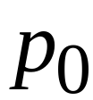
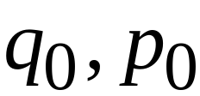
DFA
DFA
initial state
initial state
DFA
New initial state

Slide 35



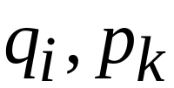
DFA
DFA
accept state
accept states
DFA
New accept states
Both constituents must be accepting states

Slide 36

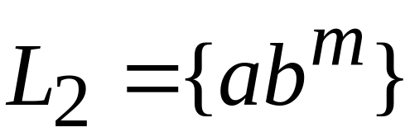








Example:

Slide 37
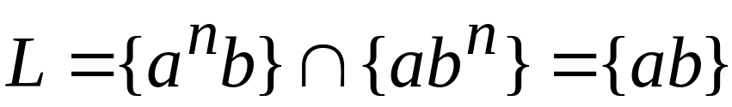







Automaton for intersection

Slide 38


simulates in parallel and
accepts string
if and only if:
accepts string
and accepts string

